Slide 1

Agile: Software Development
Agile Leadership
SoftUni Team
Technical Trainers
Software University
http://softuni.bg

Slide 2
Table of Contents
Agile Leadership
What is Leadership?
Leadership Vs Management
Agile Leadership
Five Agile Practices
Inspire a Purpose
Set up for success
Optimize flow
Govern for Greatness
Drive Innovation

Slide 3
Have a Question?
sli.do #Agile-2021

Slide 4

Agile Leadership

Slide 5
Agile Leadership
Agile Leadership & Strategy can teach future managers, executives and thought-leaders how to lead in an Agile way.
It shows in a theoretical manner how to foster a culture of Agile.
The course covers what Agile leadership is and what it is not.
Focus on the five Agile Leadership practices:
Inspire Purpose
Setup for Success
Optimize Flow
Govern for Greatness
Drive Innovation

Slide 6
Agile Leadership
3 key roles so far in Agile:
PO /project owner/
Scrum Mater
Agile Team
What about the “Management” in an Agile organization?
No organization can function without a form of management.

Slide 7
Agile Leadership
REMEMBER!
Agile can not happen without the support of the top management.
Agile is a culture. It is not about the techniques, but rather understanding its core values and implementing them.

Slide 8
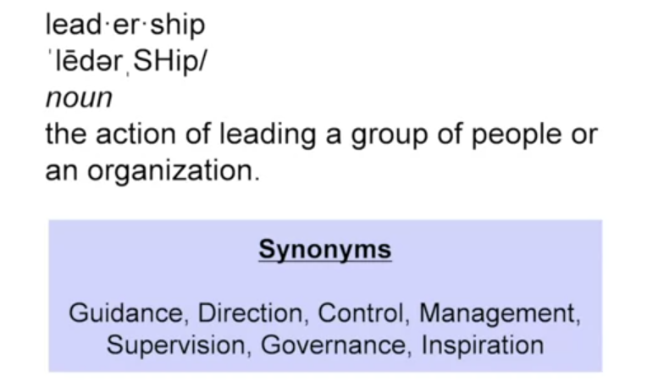
Agile Leadership
Management Vs Leadership.

Slide 9
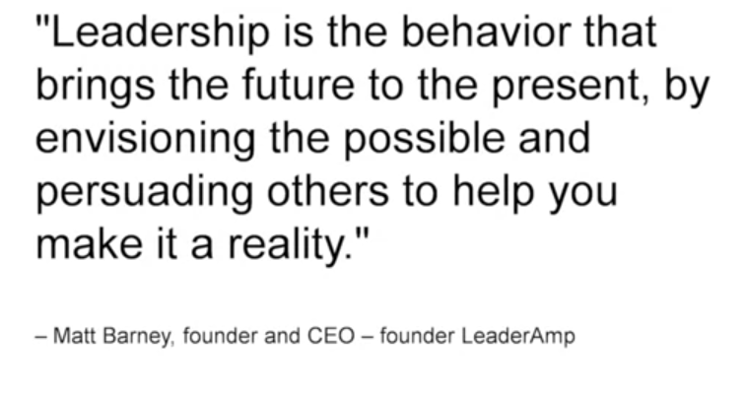
Agile Leadership
Management Vs Leadership.

Slide 10
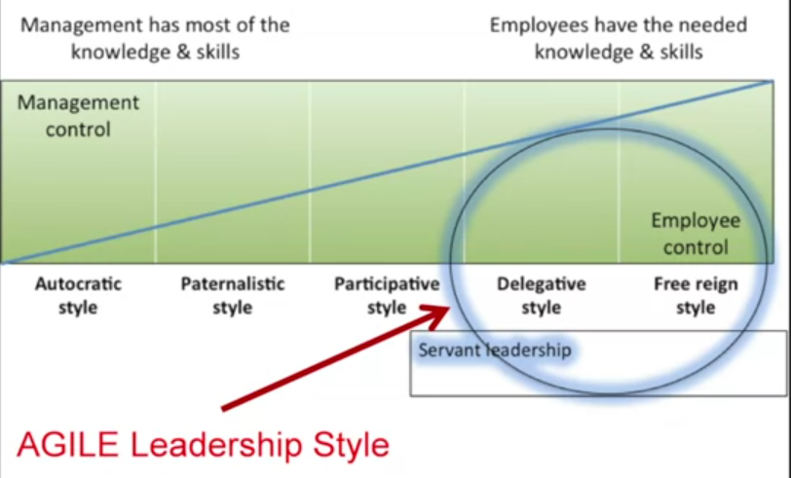
Agile Leadership
What is an Agile Leadership?

Slide 11
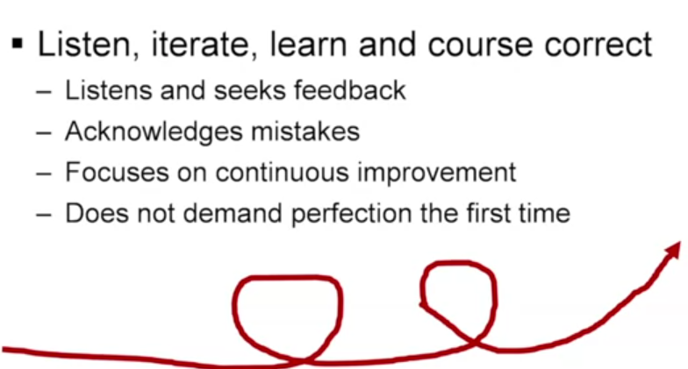
Agile Leadership
Agile Leadership is nothing but a Leadership style.
It is based on Agile core concepts, method and practices.
So, what are they?
Iterative approach.
Self-directed / Self-empowered teams.

Slide 12
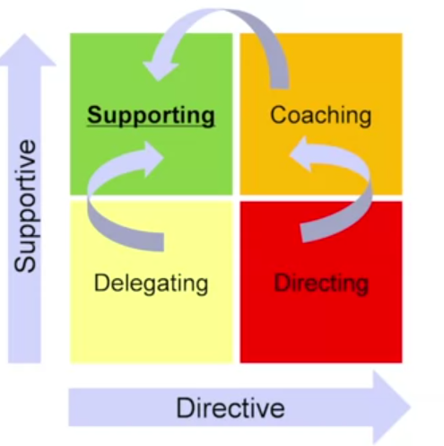
Agile Leadership
Agile Leadership is nothing but a Leadership style.
It is based on Agile core concepts, method and practices.
So, what are they?
Iterative approach.
Self-directed / Self-empowered teams.
Ability to change.

Slide 13
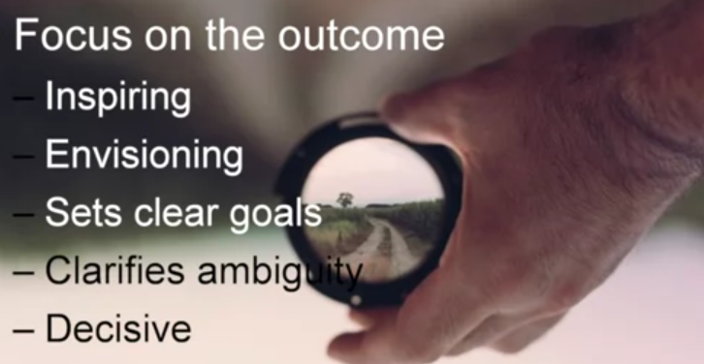
Agile Leadership
Agile Leadership is nothing but a Leadership style.
It is based on Agile core concepts, method and practices.
So what are they?
Iterative approach.
Self-directed / Self-empowered teams.
Ability to change.
Focus on the Outcome.

Slide 14
Agile Leadership
Agile Leadership is nothing but a Leadership style.
It is based on Agile core values, concepts, method and practices.
So what are they?
Iterative approach.
Self-directed / Self-empowered teams.
Ability to change.
4 core values in Agile:
Openness, Respect, Trust, Courage

Slide 15

Agile Leadership
Authenticity is number 1 quality recognized in Leadership.
Link to source

Slide 16
Agile Leadership
Agile Leaders are really Servant Leaders.
Do not underestimate the role of the first follower.
How to start a movement?

Slide 17
Agile Leadership
What do you need to know as an Agile Leader:
How to inspire people?
How to form the teams that would give you the best results?
How to distribute work ?
Measuring what matters.
Nurture Innovation.

Slide 18

Five Agile Practices

Slide 19
Five Agile Practices
Inspire Purpose
Set up for Success
Optimize Flow
Govern for Greatness
Drive Innovation

Slide 20
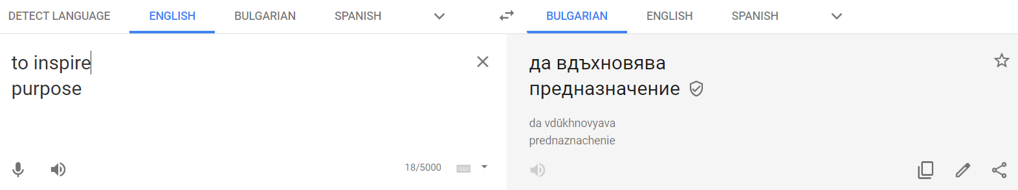
Inspire Purpose

Slide 21
Inspire a purpose
The golden circle.
HOW?
WHY?
WHAT?

Slide 22
Inspire a purpose
Why?
How?
What?
1 – Where are we now?
2 – Where do we want to go?
3. How do we get there?
5. Strategy implementation
4. What do we have to do?

Slide 23
Inspire a purpose
1 – Where are we now?
2 – Where do we want to go?
3. How do we get there?
5. Strategy implementation
4. What do we have to do?
3 hours
2 hours
2 hours
5 hours
2 hours
DAY 1
DAY 2

Slide 24
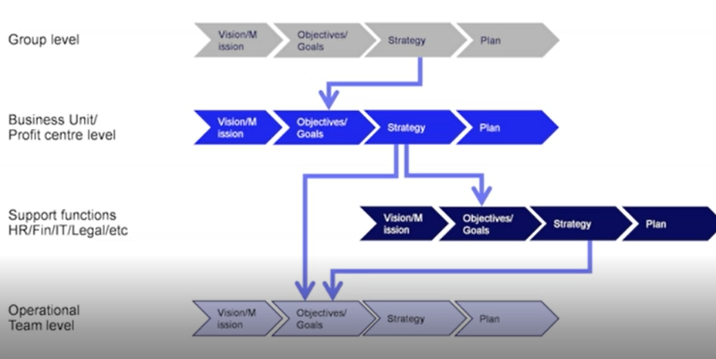
Inspire a purpose – forming the strategy
Is the strategy only for…strategists?
Strategy flow through the different layers of the organization.
Corporate level (helicopter view)
Level below – Business Unit.
Level below – Operational Unit
Strategy is being cascaded.
Each unit should know the strategy.

Slide 25
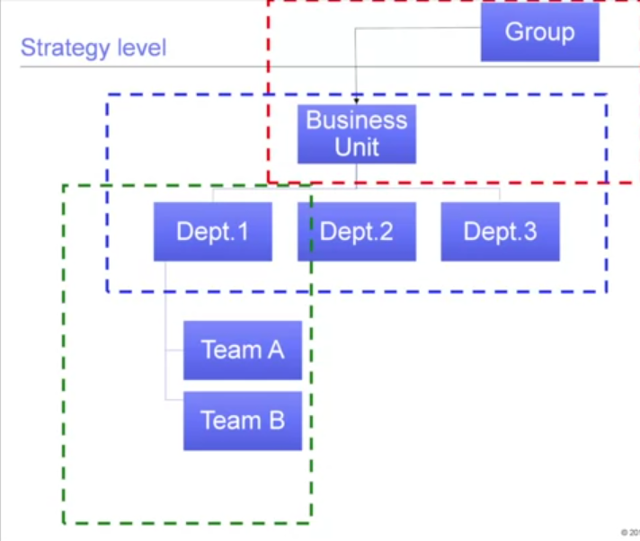
Inspire a purpose – how do you do it?
Workshops are highly recommended.
Bootcamps.
Mixing through the layers.
2 days is probably right.
Face 2 Face.

Slide 26
Five Agile Practices
Inspire Purpose
Set up for Success
Optimize Flow
Govern for Greatness
Drive Innovation

Slide 27
Set up for Success
Form teams
Distribute works
Measure what matters

Slide 28

Set up for Success
Form teams
Keep the size reasonable – 7 to 10 employees per team.

Slide 29

Set up for Success
Form teams
Keep the size reasonable – 7 to 10 employees per team.
Co-locate if possible – proven as more efficient.
Cross functional & Diverse…but what does this mean?
Able to perform the functions expected.
Healthy mixture of experience, background, knowledge and skills
Different people think differently.
Empower your team.

Slide 30

Set up for Success
Form the Teams.
Distribute works.
Make sure the team is doing the right work.
Make sure the responsibilities are clear and look for gray zones.
What practices can help us achieve that?

Slide 31

Set up for Success
Distribute works
Make sure the team is doing the right work
Make sure the responsibilities are clear
Do not load the team with multiple projects, but rather keep the number of projects low and look for completion.
Scrum team would normally work one project at a time.
Create the right setting for the team.

Slide 32
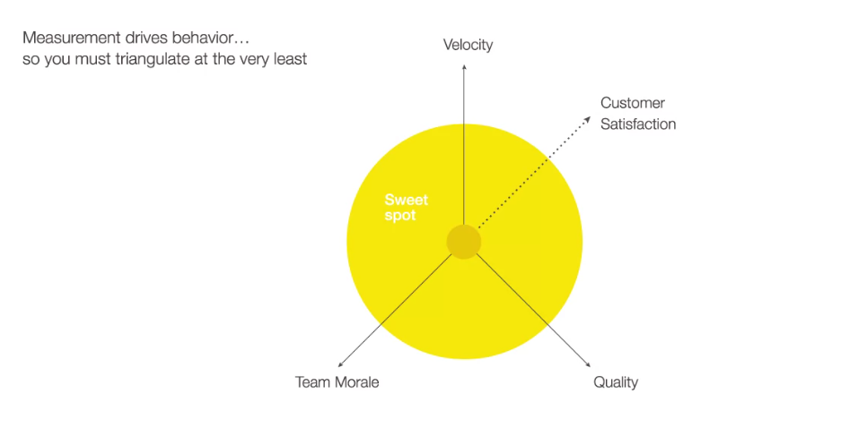
Set up for Success
Form the team/s.
Distribute work.
Measure what matters.

Slide 33
Set up for Success
Measure what matters.
What you measure drives team behavior.
Establish well defined / well balanced measurements.
Agile is about iterations … to improve you need to measure.
Always explain WHY isomething is the measured

Slide 34
Five Agile Practices
Inspire Purpose
Set up for Success
Optimize Flow
Govern for Greatness
Drive Innovation

Slide 35
Optimize (work) Flow
Visualize work
Observe for waste and barriers
Drive continues improvement

Slide 36
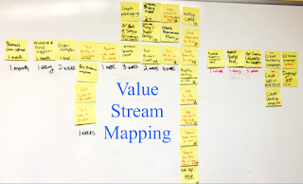
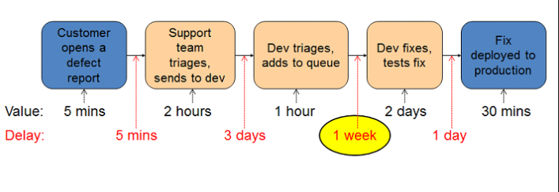
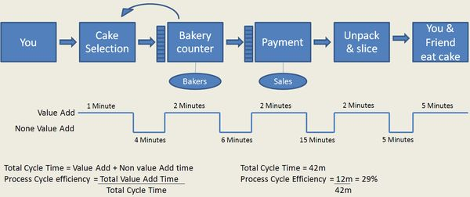
Optimize (work) Flow
Visualize work
Agile Value Streaming Map.
Work across silos.
Work with peers.

Slide 37
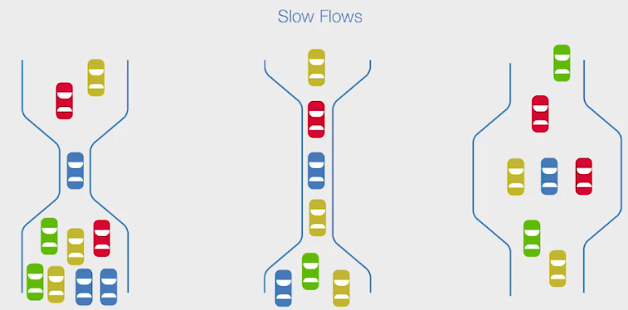
Optimize (work) Flow
Visualize work
Observe for waste and barriers
When the work is visual, it is easier to spot issues.
Think of the different types of waste (Lean, Lean Six Sigma).

Slide 38
Optimize (work) Flow
Increase efficiency of bottleneck
Make sure its free of defect input
Improve the process (reduce wasteful steps)
Automate
Up-skill and train
Reschedule work
Increase work time
Minimize down time
Add more resources – Notice how adding more resources is the last option!
Decrease input to bottleneck
Manage the onramp

Slide 39
Optimize (work) Flow
What is a “Leadership Smash”?
Define the problem
Root cause
Solution options
Proposed solution
Nobody leaves the room until a proposed solution is presented.

Slide 40
Optimize (work) Flow
Visualize work
Observe for waste and barriers
Drive continues improvement
KAIZEN – Small continues improvements.
Do it together with the team.

Slide 41
Optimize (work) Flow
Visualize work
Observe for waste and barriers
Drive continues improvement

Slide 42
Five Agile Practices
Inspire Purpose
Set up for Success
Optimize Flow
Govern for Greatness
Drive Innovation

Slide 43
Govern for Greatness
Doing the Right work.
Doing the work Right.
Walk the line.
Ask questions.
Measurements.

Slide 44
Five Agile Practices
Inspire Purpose
Set up for Success
Optimize Flow
Govern for Greatness
Drive Innovation

Slide 45
Drive Innovation
How to create the right environment for innovation?
Safe to fail.
Can do attitude.
Competition.
Reward & Recognize.

Slide 46
Drive Innovation
How to create the right environment for innovation?
Don’t overburden.

Slide 47
Drive Innovation
How to create the right environment for innovation?
Don’t overburden.
Set the right Goals.

Slide 48
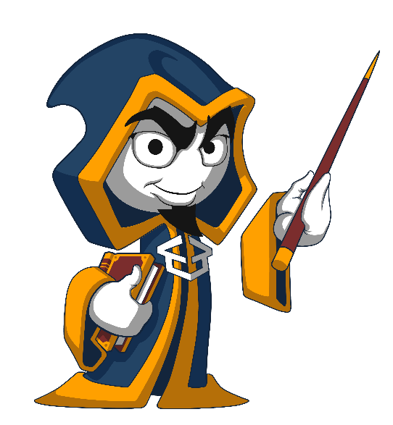
Summary
Agile Leadership is a management style.
Think of the Servant Leadership.
Practices for nurturing Agile Leadership.
…
…
…

Slide 50













SoftUni Diamond Partners

Slide 51




SoftUni Organizational Partners

Slide 52





Trainings @ Software University (SoftUni)
Software University – High-Quality Education, Profession and Job for Software Developers
softuni.bg
Software University Foundation
http://softuni.foundation/
Software University @ Facebook
facebook.com/SoftwareUniversity
Software University Forums
forum.softuni.bg

